Slide 1
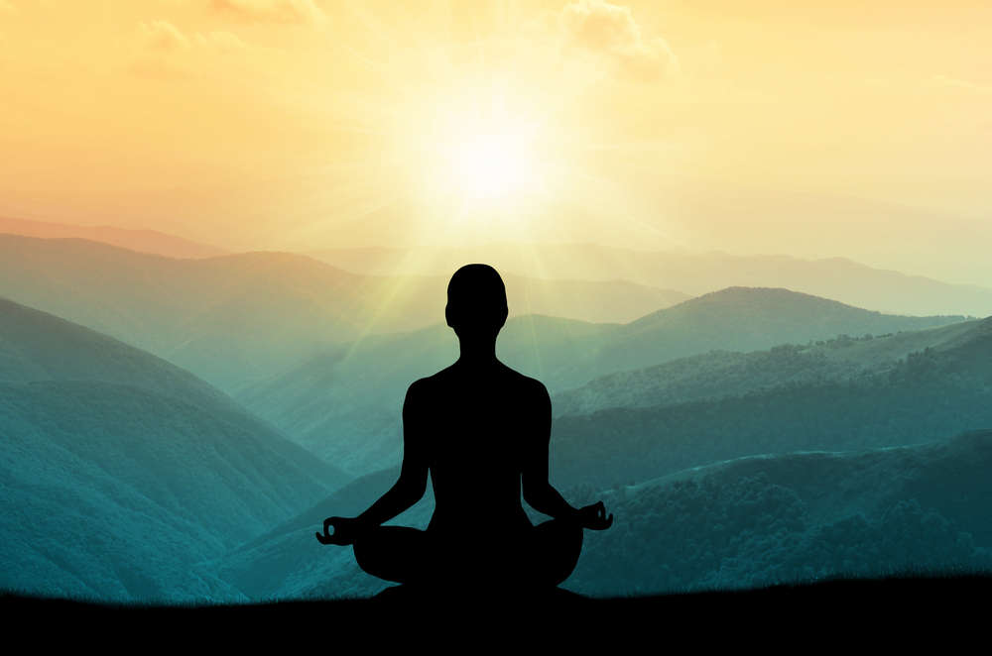
The Relationship of Mindfulness & Meditation:
Tools for Wellness
Linnea Hofmeister, LCSW, LADC, CCS
Notes:
Introduction- Bio- I identify as a peer; I have struggled with mental illness and substance use disorder from a young age. Due to life circumstances, anxiety touched me at the tender age of 5. I truly cannot remember a time where I did not feel anxious. As a teen I started to self-medicate and by the time I was 24, I found opiates. By the age of 32, I had experienced a psychiatric hospitalization and a CSU stay. That’s where my road to recovery and wellness started. I had a medication provider who referred me to a mental health IOP where I learned DBT skills. DBT consists of four modules. Mindfulness, Distress Tolerance, Emotion Regulation and Interpersonal Effectiveness. I have been practicing mindfulness for the last 20 years. This has allowed me to do things that I never thought that I could do. I have obtained career goals, obtained personal goals and been married to my husband for over 30 years. Mindfulness has worked for me; I cannot guarantee that these tools will work for you.

Slide 2
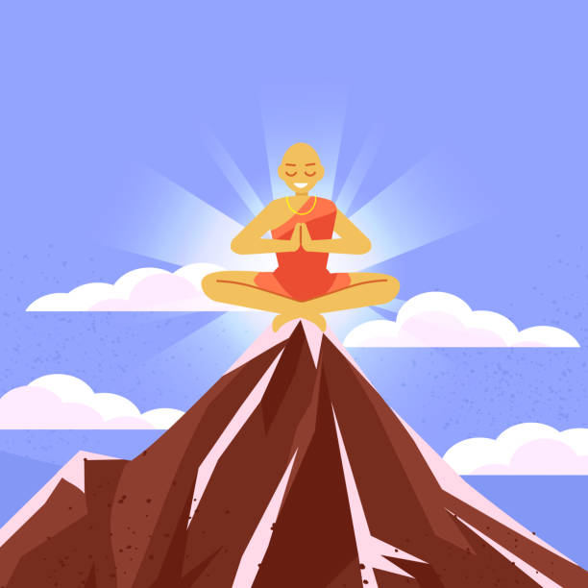
Notes:
People are often turned off by incorporating Mindfulness into their everyday lives because when someone mentions it your immediate thought is of a Buddhist Monk on a mountain top in the lotus position.
That is actually meditation- a specific form of meditation called Vipassana Meditation- This is known as insight meditation. When a Buddhist meditates, they believe that they can see things as they really are. This allows them to gain realization and understand the vulnerability of things and the nature of reality.

Slide 3
Grounding Exercise
Notes:
https://www.youtube.com/watch?v=dpqX3Fthw_E

Slide 4
Meditation:
Concentration
Setting aside time for practice
Mindfulness:
Awareness
Being tuned into what is going on in and around you.
Fully present; in the now
Notes:
Have you ever thought about practicing Mindfulness but you are a little “iffy” when it comes to Meditation? Luckily, for you, mindfulness and meditation are not the same thing. I’m going to explain what the differences are between Mindfulness & Meditation.
Mindfulness is quality while Meditation is practice.
Jon Kabat-Zinn- the father of mindfulness- defines it as “the awareness that arises through paying attention, on purpose, in the present moment, non-judgmentally.”
Whereas Meditation is defined as “a practice where an individual uses a technique – such as mindfulness or focusing the mind on a particular object, thought, or activity – to train attention and awareness, and achieve a mentally clear and emotionally calm and stable state”

Slide 5
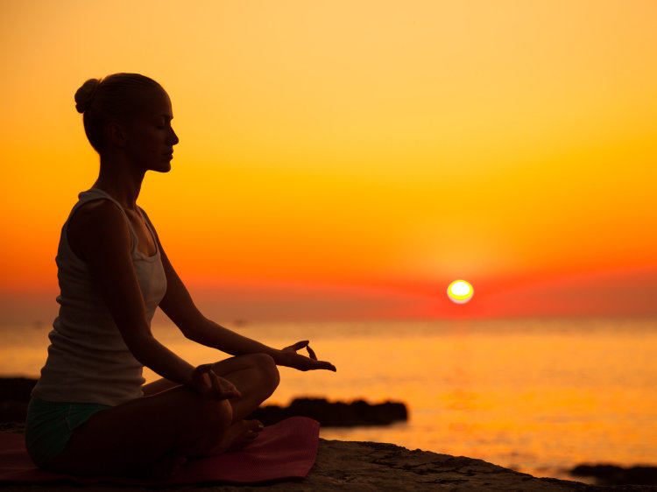
What is Mindfulness?
Notes:
What is Mindfulness?
When you are consciously bringing your wandering mind back to the present moment, you are cultivating mindfulness. You can do that in everyday life by tuning into your surroundings. When you are practicing Mindfulness, you are giving one thing your undivided attention.
For example: If you are doing the dishes, you are doing JUST the dishes with intention. This means that you are NOT thinking about your grocery list, what to make for dinner or if you remembered to switch the laundry over. You are instead listening to the bubbles pop, smelling the dish soap, concentrating on the puffs of bubbles, and feeling the warmth of the water. You are fully using your senses and clearing your mind of anything else.
You do not have to meditate in order to be mindful. Mindfulness is a nonjudgmental awareness of your thoughts, sensations, surroundings, and emotions. Meditation is one tool for developing mindfulness but isn't the only tool.

Slide 6
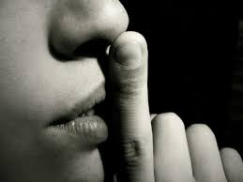
Practicing Mindfulness: Your Everyday Life
Notes:
We are going to discuss some strategies you can use to practice mindfulness in your everyday life. These strategies are easy to incorporate into your daily routines and after a while, you won’t even realize that you are practicing a skill. It will become part of who you are and what you do daily to take care of yourself.

Slide 7
Notice Your Bed
Notes:
When your alarm clock goes off, do you jump right out of bed? Hit the snooze a few times? When you awake in the morning, take just a few moments to notice your sheets against your skin, the softness of your pillow on your face, the warmth of your comforter and the light shining in through your window.

Slide 8
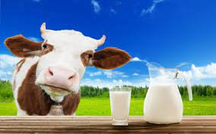
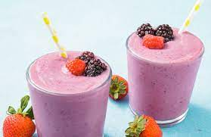
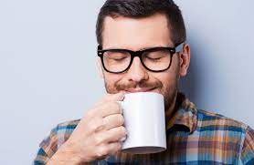
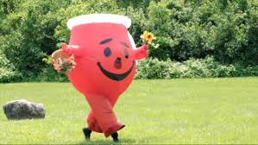
Taste Your Morning Beverage
Notes:
Take just a second to really taste your beverage. Smell the aroma, feel the temperature on your lips, close your eyes and pay attention to the taste- is it sweet or bitter? Are you satiated? Is the liquid thick or thin? Can you swallow it easily?

Slide 9
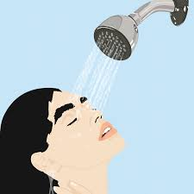
Enjoy a Shower
Notes:
Have you ever really paid attention to your shower? If you go through these daily tasks on autopilot, you’re missing a lot of enjoyable, relaxing moments. Notice what the soap feels like on your skin, the smell, mindfully, with full intention, massage the shampoo into your hair and scalp.

Slide 10
Spend Time With Loved Ones
Notes:
Look for something new in your daily interactions with others. With nonjudgmental curiosity observe others moods, energy, and how they greet you. Remember, from a nonjudgmental stance, not adding anything to your observations. Can you notice something new about them?

Slide 11
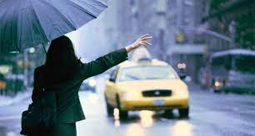
Drive With Intention
Notes:
A lot of us have had the experience where you have arrived at your destination not remembering the time between point A and point B. The next time you’re behind the wheel, notice the steering wheel, how it feels in your hands, and the warmth of the heater or coolness of the AC. If you are taking public transportation- first off- give yourself credit for doing this- it’s really difficult to trust in someone else. Then, tune into the seat you’re sitting in, examine your surroundings, notice who is sitting near you and notice the sounds and smells of the bus.

Slide 12
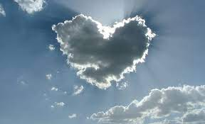
Look At The Sky
Notes:
Simply examine the sky when you’re outside. Are there any clouds? What do they look like? Are there any birds, planes or trees obstructing the view?

Slide 13
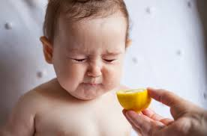
Mindfully Eat a Meal
Notes:
Before you dig into that next meal, take a few moments to examine it. What colors do you see? What textures are there? What does it smell like? Take small bites. Taste the food. Is it crunchy, smooth or soft? Do the flavors change as you chew and swallow? Try to keep eating slowly and mindfully. If your mind wanders off, gently bring it back to mindfully eating.

Slide 14
Notes:
https://www.youtube.com/watch?v=d984L-IZhIw

Slide 15
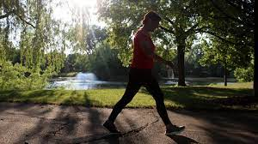
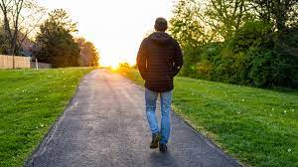
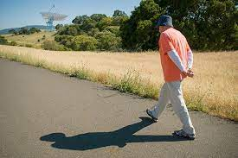
Walk with Yourself
Notes:
Stretch your legs in the afternoon and get out into the fresh air. Engage with the outdoors. Try to notice something that you have never seen before. Look everywhere- the trees, the earth, the sky. Do you hear anything? Birds, a train, sirens? Tune into your legs and feet. How does it feel when your feet connect to the ground? Is it hard or soft? Are you on pavement or the grass?

Slide 16
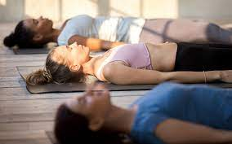
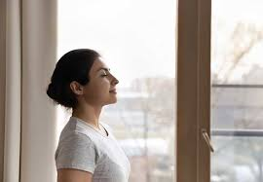
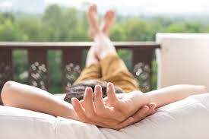
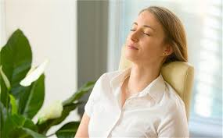
Body Scan
Notes:
Take a second to tune into your body. Start at your toes and work your way up. Observing, nonjudgmentally, each part of your body until you reach the top of your head. Be aware of what you’re feeling. Are your muscles tight? Is there a tingling anywhere? Are you hot, cold or just right? Does your mind wander? What are you feeling? Are you anxious? Sad? Lonely? Hurt? Notice those feelings and slowly and gently bring your attention back to just noticing your body.

Slide 17
5 Minute Body Scan
Notes:
https://www.youtube.com/watch?v=7_ifWkZQ7QQ

Slide 18
Notice Phone Use
Notes:
Do you check Facebook or any other social media without even realizing it? Start to tune into what you’re doing and check in with yourself to see if you could be doing something else with your time. Remember- nonjudgmental position- just notice.

Slide 19
Observe a Sunset
Notes:
Step outside some evening and appreciate the beautiful colors of a sunset. Try to notice something that you never have before. Is there a cloud or shape that reminds you of someone or something? Has the air temperature changed as the sun is setting? Notice the different colors.

Slide 20
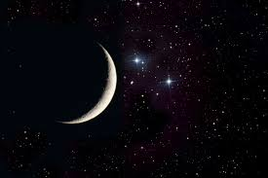
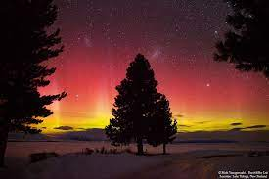
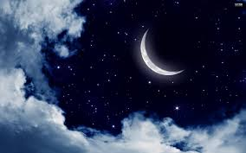
Check Out The Night Sky
Notes:
Peek at the moon and stars. When was the last time that you really LOOKED at the moon and stars? Are there some stars that are brighter? Fainter? Examine the moon- look for the darker and lighter spots.

Slide 21
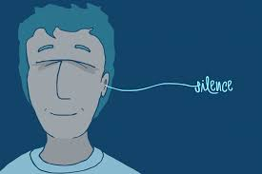
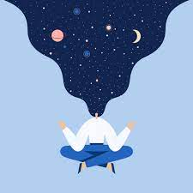
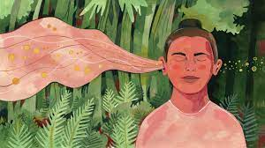
Listen to the Silence
Notes:
As you are getting ready to end your day and it is time to crawl into bed, STOP- close your eyes and listen. What do you hear? What do you not hear? Notice the sounds with curiosity. Allow yourself to hear the sounds and apply texture or colors to them.

Slide 22
Notes:
Practicing mindfulness throughout your day can help train your mind to be fully in the present moment observing what is happening and not thinking about the past or worrying about the future.

Slide 23
What is Meditation?
Notes:
What does Meditation mean to you- Allow for responses--
There are several different kinds of meditation. Not all meditation styles are right for everyone. Each require different skills and mindsets. How are you going to know what is right for you? Whatever feels comfortable to you is what will benefit you the most. If you’re comfortable with it, you will be more inclined to use it.

Slide 24
Spiritual Meditation
Notes:
often referred to as prayer, spiritual meditation focuses on a deeper understanding of the spiritual/religious meaning and connection with a higher power.

Slide 25
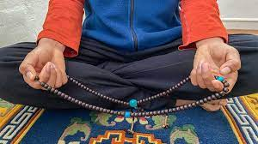
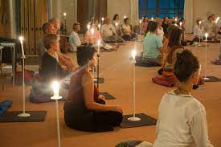
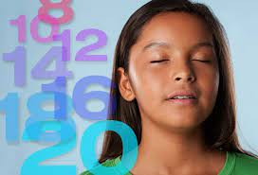
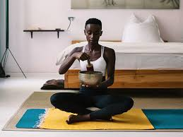
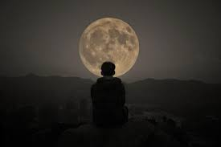
Focused Meditation
Notes:
Involves concentration using the five senses. For example; Counting mala beads, listening to a gong, staring at the flame of a candle, counting your breaths or staring at the moon.

Slide 26
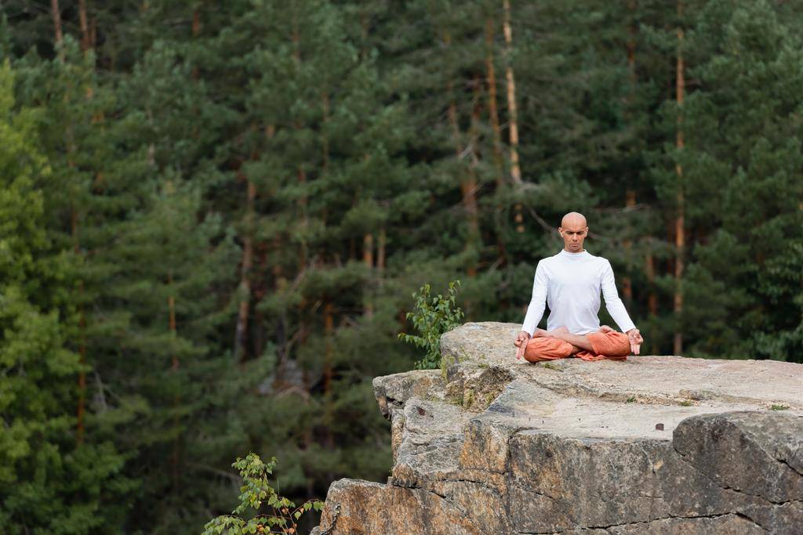
Mantra Meditation
Notes:
This type of meditation uses a repetitive sound to clear the mind. The sound can be a word, phrase or sound. The most common is “om”. A mantra can be spoken out loud or repeated internally. After repeating the mantra for some time you will be more alert and in tune with your surroundings. This allows you to experience deeper awareness. Some individuals chose this form of meditation because they find it easier to concentrate on a word rather than their breath. This is a great practice for individuals who enjoy repetition and dislike silence.

Slide 27
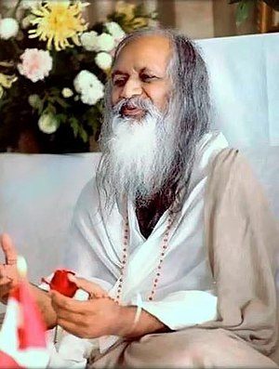
Transcendental Meditation
Maharishi Mahesh Yogi created Transcendental Meditation in India in the Mid 1950’s.
The Maharishi taught thousands of people during a series of world tours from 1958 to 1965, expressing his teachings in spiritual and religious terms.
His meditation technique was practiced by celebrities, most prominently members of The Beatles and The Beach Boys.
Notes:
This particular type of meditation has been the subject of numerous studies. TM refers to a specific practice that is designed to quiet the mind and induce a state of peacefulness and calmness. It involves the use of a mantra and is best taught by a certified TM practitioner.

Slide 28
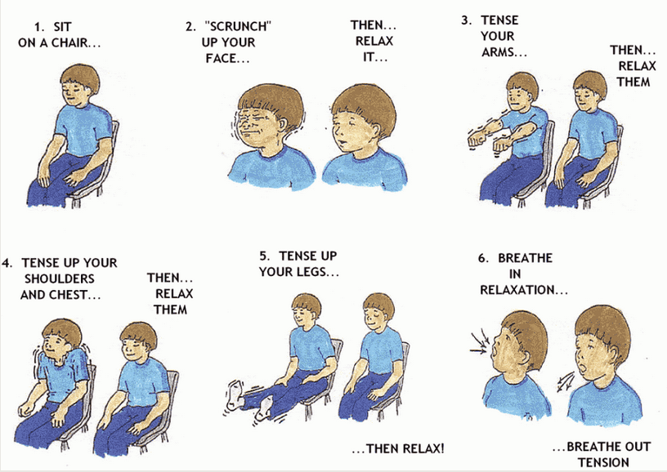
Progressive Muscle Relaxation
Notes:
This is a meditation aimed at reducing tension in the body and promoting relaxation. Often when practicing this meditation, individuals will progressively tighten and release certain muscle groups in the body. This practice may involve imagery such as a wave gently flowing through your body to relax muscles. This form of meditation is most often used before bed to wind down.

Slide 29
Deep Muscle Relaxation
Notes:
https://www.youtube.com/watch?v=GSPdoDFSglk&t=85s

Slide 30
Chair Yoga Experience
Notes:
https://www.youtube.com/watch?v=IKW8X0-2Eww&t=335s

Slide 31
.
Linnea Hofmeister, LCSW, LADC, CCS
lhofmeister@mainebehavioralhealth.org
(207) 458-3877

