Slide 1
Harm Reduction: The Role of Peers
Haner Hernandez, Ph.D., CPS, CADCII, LADCI
hanerhernandez@aol.com
413-627-1601
Notes:
Place your title on this first slide and include any subtitle.
DO NOT CHANGE THE FORMAT OF THIS TEMPLATE. If you are creating ATTC-branded slides, you must use this template. If you move around boxes, make sure to check the reading order. If you widen any boxes they must not overlap any other box.
IF YOU ADD ANY GRAPHICS, you will need to add ALT TEXT and check READING ORDER.
(If the notes on ALT TEXT and READING ORDER do not make sense to you, please let the ATTC National Coordinating Office know to help with remediation.)

Slide 2
Learning Objectives
Describe the philosophy, principles, and practice of harm reduction and the role of people in recovery;
Describe at least 4 techniques and strategies for engaging people in Harm Reduction; and
Describe their role in promoting, supporting and sustaining meaningful change.
Notes:
Of course you know that using these templates does not mean that your presentation is 508 compliant. There is much more to making a presentation 508 compliant than just using templates. However, if you use these slides it makes remediation easier and quicker.

Slide 3
Recovery Definition (SAMHSA)
A process of change through which individuals improve their health and wellness, live a self-directed life, and strive to reach their full potential. The four dimensions of recovery are:
Health: living in a physically and emotionally healthy way as well as overcoming or managing one’s disease(s) or symptoms;
Home: a stable, safe and recovery conducive place to live;
Purpose: meaningful daily activities, such as a job, school, volunteerism, family caretaking, or creative endeavors, and the independence, income and resources to participate in society; and
Community: relationships and social networks that provide support, friendship, love, and hope.

Slide 4
William White (www.williamwhitepapaers.com)
“The experience of a meaningful productive life within the limits imposed by the risks of addiction. Recovery is both the acceptance and transcendence of limitation. It is the achievement of optimal health – the process of rising above and becoming more than an illness.
Recovery in contrast to treatment is both done and defined by the person’s recovery.”

Slide 5
Let’s Begin with a Critical
and Grounding Question:
When are People in Recovery?
When They Say They Are!
Notes:
Of course you know that using these templates does not mean that your presentation is 508 compliant. There is much more to making a presentation 508 compliant than just using templates. However, if you use these slides it makes remediation easier and quicker.

Slide 6
What Misconceptions Exists and Persist About Harm Reduction?
Condones Active Drug Use
No Evidence of Effectiveness
Designed to Control People
People who Promote it Don’t Understand Substance Use Disorders
Waste of Resources
Notes:
Of course you know that using these templates does not mean that your presentation is 508 compliant. There is much more to making a presentation 508 compliant than just using templates. However, if you use these slides it makes remediation easier and quicker.

Slide 7
Federal Changes Related to Harm Reduction
SAMHSA, CDC, ONDCP 2 Day Summit on Harm Reduction in December 2021
Harm Reduction Defined, Principles Established
Steering Committee Established and Providing Input
National Harm Reduction Technical Assistance Center Established
Millions in Initial Funding Made Available; More to Follow!

Slide 8
Definition of Harm Reduction
Harm Reduction is a set of practical strategies and ideas aimed at reducing the negative consequences associated with drug use.
Harm reduction is also a movement for social justice built on a belief in, and respect for, the rights of people who use drugs.
Source: National Harm Reduction Coalition, 2021

Slide 9
Raise Your Hand if You Practice Harm Reduction

Slide 10
Reducing Harm From What?
Substance Use and Mental Health Challenges
Overdose
HIV/AIDS and Sexually Transmitted Infections/Diseases
Hepatitis B, and C
Criminal Justice Involvement
Experiences with Homelessness
Other Health Conditions

Slide 11
Why Should Peers Support Harm Reduction?

Slide 12
Stages of Change
Developed by Prochaska & DiClemente
Among many other considerations they understood that “...individuals go through a logical series of decision changes on the way to adopting a new behavior” (1982).

Slide 13
Framing and Context for Stages of Change
Change is a Process, Rather than an Event.
Involves Cognitive and Behavioral Processes.
Reoccurrences Should Never be Penalized.
Requires Patience, Time, Resources, and Supports.

Slide 14
Context for Stages of Change
Behavior Change Occurs in Five Stages:
Pre-Contemplation
Contemplation
Preparation
Action
Maintenance

Slide 15
Harm Reduction Principles (National Harm Reduction Coalition, 2021)
Accept, for better or worse, that licit and illicit drug use is part of our world and chooses to work to minimize its harmful effects rather than simply ignore or condemn them.
Establish quality of individual and community life and well-being — not necessarily cessation of all drug use — as the criteria for successful interventions and policies.
Ensure that people who use drugs and those with a history of drug use routinely have a real voice in the creation of programs and policies designed to serve them.

Slide 16
Harm Reduction Principles (cont.)
Recognize that the realities of poverty, class, racism, social isolation, past trauma, sex-based discrimination, and other social inequalities affect both people’s vulnerability to and capacity for effectively dealing with drug-related harm.
Understand drug use as a complex, multi-faceted phenomenon that encompasses a continuum of behaviors from severe use to total abstinence, and acknowledges that some ways of using drugs are clearly safer than others.
Call for the non-judgmental, non-coercive provision of services and resources to people who use drugs and the communities in which they live in order to assist them in reducing attendant harm.

Slide 17
Harm Reduction Principles (end)
Affirm people who use drugs (PWUD) themselves as the primary agents of reducing the harms of their drug use.
Seek to empower PWUD to share information and support each other in strategies which meet their actual conditions of use.
Do not attempt to minimize or ignore the real and tragic harm and danger that can be associated with illicit drug use.

Slide 18
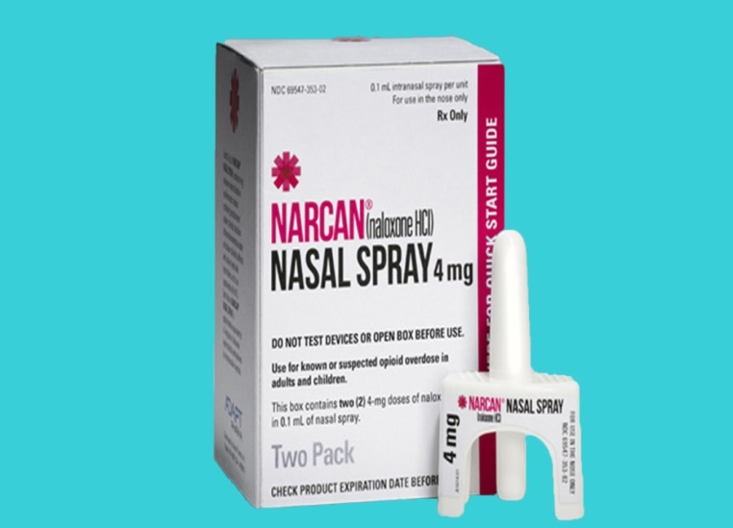
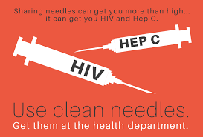
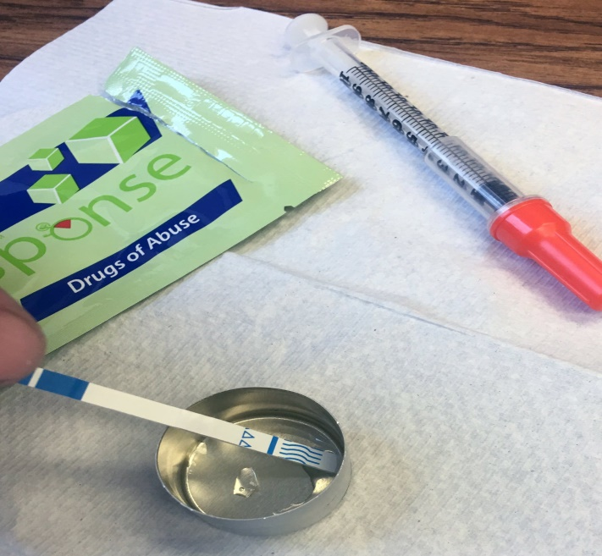
Harm Reduction Strategies and Tools
Never Use Alone!
Wound Care
Referrals to Care
Prescription Monitoring Programs
Notes:
1- Substance test kits including fentanyl test strips
2- Use of Narcan to reverse overdose
3- Needle exchange programs
4- Giving individuals supplies to promote sterile injection and reduce infectious disease transmission through injection drug use, including sterile needles.
5- Informing individuals to never use alone

Slide 19
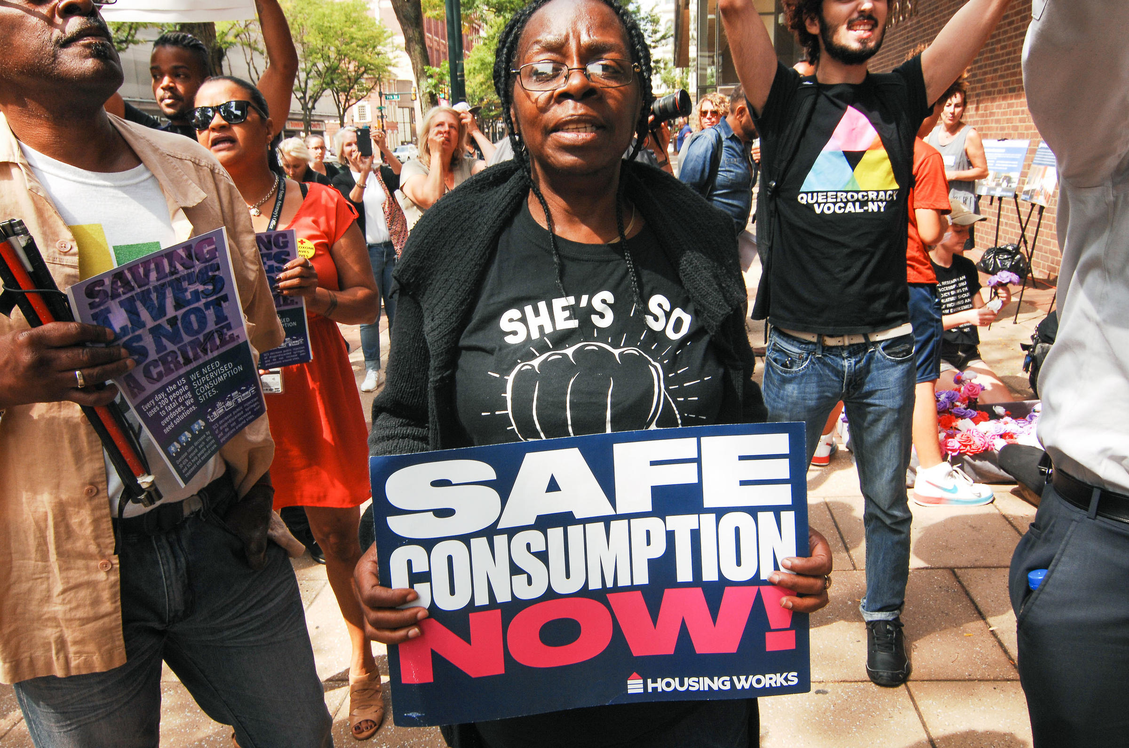
What’s the Most Controversial Strategy in Harm Reduction Today?

Slide 20
Peer Roles in Supporting Harm Reduction
Understand SUDs and MH as a Public Health Matter, Not a Criminal Justice Issue
End Punitive Approaches, Listen to Support, Never to Judge
Support Harm Reduction as a Pathway of Recovery, Wellness, and Improving Health Outcomes
Attend to Trauma and Lead with Restorative Justice

Slide 21
Peer Roles in Supporting Harm Reduction
Partner with Harm Reduction Practitioners and Educate Others
Use Strength Based Language, Eliminate Stigma
Humanize People, Build Equity, Lead with Empathy and Compassion
Advocate with Participants for Service Access and Quality of Care
Participate in the Development and Implementation of Harm Reduction Policies

Slide 22
Questions and Discussion

Slide 23
іGracias! - Thank You!

